Slide 1
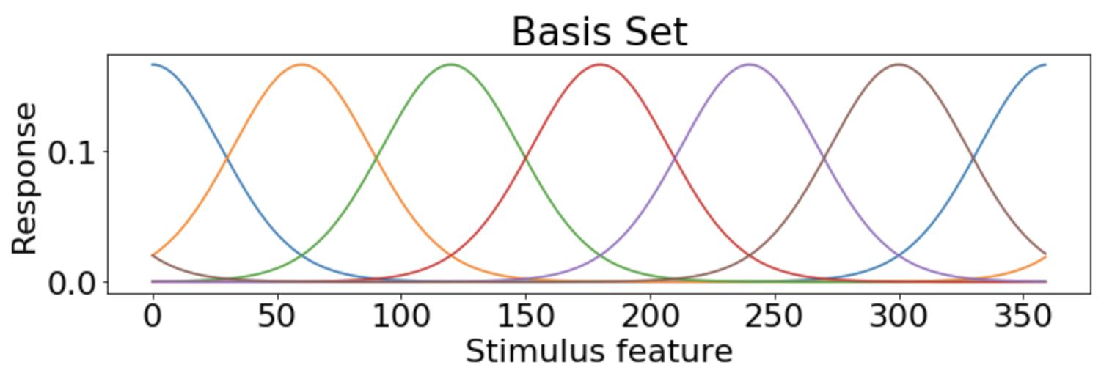
Basic run-through of standard IEM pipeline
1. Create the encoding model
Select a basis set (set of stimulus-selective feature channels) to serve as a simple linear encoding model
Each gaussian is one channel that composes the basis set
2. Collect data
Run a neuroimaging experiment where you (typically) only sample the features that are the centers of the channels
(e.g., [0, 60, 120, 180, 240, 300])
3. Train encoding model
Use training data to find the typical activations, per voxel, associated with each channel’s stimulus feature
(i.e., solve for “weights” in this equation: basis_set[trial_features,:] * weights = training_data)
4. Invert the encoding model (this is decoding!)
Instead of using voxel activations and stimulus feature as inputs to output “weights”, use the trained “weights” and the voxel activations to output the stimulus feature
5. Evaluate reconstructed channel response profiles
Since each channel is associated with a stimulus feature, these predictions are “stimulus reconstructions”

Slide 2
Basic run-through of standard IEM pipeline
1. Create the encoding model
Select a basis set (set of stimulus-selective feature channels) to serve as a simple linear encoding model
Each gaussian is one channel that composes the basis set
2. Collect data
Run a neuroimaging experiment where you (typically) only sample the features that are the centers of the channels
(e.g., [0, 60, 120, 180, 240, 300])
3. Train encoding model
Use training data to find the typical activations, per voxel, associated with each channel’s stimulus feature
(i.e., solve for “weights” in this equation: basis_set[trial_features,:] * weights = training_data)
4. Invert the encoding model (this is decoding!)
Instead of using voxel activations and stimulus feature as inputs to output “weights”, use the trained “weights” and the voxel activations to output the stimulus feature
5. Evaluate reconstructed channel response profiles
Since each channel is associated with a stimulus feature, these predictions are “stimulus reconstructions”

Slide 3
Basic run-through of standard IEM pipeline
1. Create the encoding model
Select a basis set (set of stimulus-selective feature channels) to serve as a simple linear encoding model
Each gaussian is one channel that composes the basis set
2. Collect data
Run a neuroimaging experiment where you (typically) only sample the features that are the centers of the channels
(e.g., [0, 60, 120, 180, 240, 300])
3. Train encoding model
Use training data to find the typical activations, per voxel, associated with each channel’s stimulus feature
(i.e., solve for “weights” in this equation: basis_set[trial_features,:] * weights = training_data)
4. Invert the encoding model (this is decoding!)
Instead of using voxel activations and stimulus feature as inputs to output “weights”, use the trained “weights” and the voxel activations to output the stimulus feature
5. Evaluate reconstructed channel response profiles
Since each channel is associated with a stimulus feature, these predictions are “stimulus reconstructions”

Slide 4
Basic run-through of standard IEM pipeline
1. Create the encoding model
Select a basis set (set of stimulus-selective feature channels) to serve as a simple linear encoding model
Each gaussian is one channel that composes the basis set
2. Collect data
Run a neuroimaging experiment where you (typically) only sample the features that are the centers of the channels
(e.g., [0, 60, 120, 180, 240, 300])
3. Train encoding model
Use training data to find the typical activations, per voxel, associated with each channel’s stimulus feature
(i.e., solve for “weights” in this equation: basis_set[trial_features,:] * weights = training_data)
4. Invert the encoding model (this is decoding!)
Instead of using voxel activations and stimulus feature as inputs to output “weights”, use the trained “weights” and the voxel activations to output the stimulus feature
5. Evaluate reconstructed channel response profiles
Since each channel is associated with a stimulus feature, these predictions are “stimulus reconstructions”

Slide 5
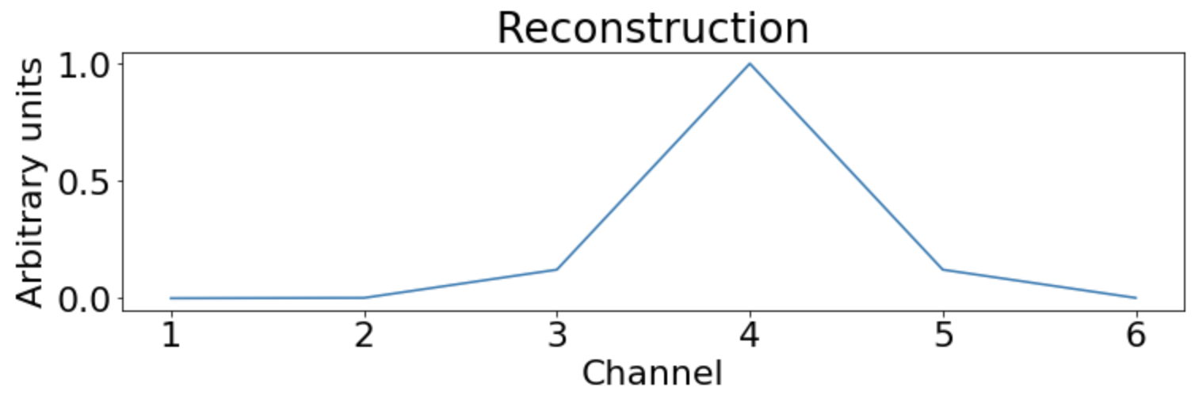
Basic run-through of standard IEM pipeline
1. Create the encoding model
Select a basis set (set of stimulus-selective feature channels) to serve as a simple linear encoding model
2. Collect data
Run a neuroimaging experiment where you (typically) only sample the features that are the centers of the channels
(e.g., [0, 60, 120, 180, 240, 300])
3. Train encoding model
Use training data to find the typical activations, per voxel, associated with each channel’s stimulus feature
(i.e., solve for “weights” in this equation: basis_set[trial_features,:] * weights = training_data)
4. Invert the encoding model (this is decoding!)
Instead of using voxel activations and stimulus feature as inputs to output “weights”, use the trained “weights” and the voxel activations to output the stimulus feature
5. Evaluate reconstructed channel response profiles
Since each channel is associated with a stimulus feature, these predictions are “stimulus reconstructions”

Slide 6
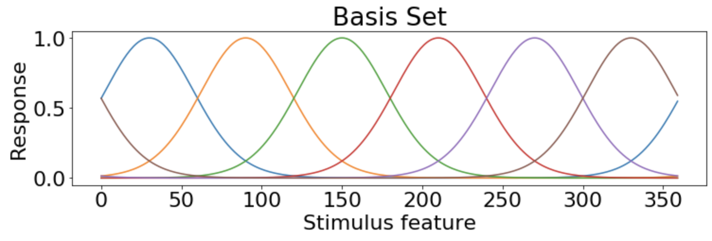
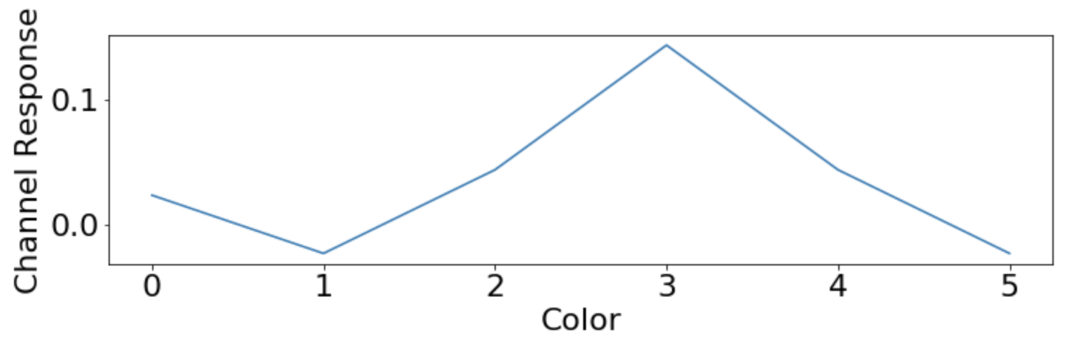
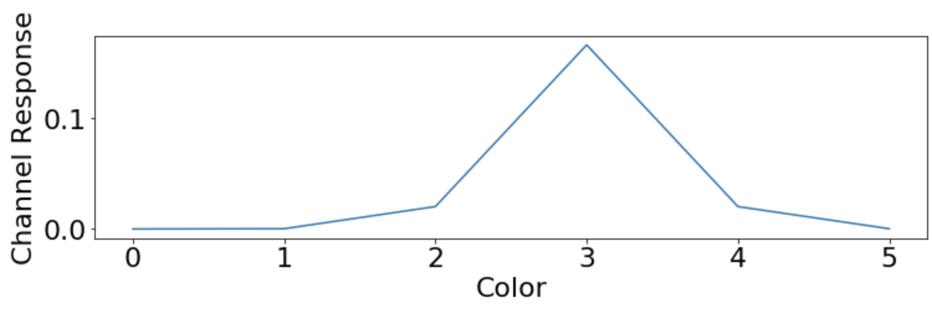
Basic run-through of standard IEM pipeline
Ground Truth
What happens if we have perfect data but a basis set shifted from the ground truth?
Channel
Channel

Slide 7
Basic run-through of standard IEM pipeline
1. Create the encoding model
Select a basis set (set of stimulus-selective feature channels) to serve as a simple linear encoding model
2. Collect data
Run a neuroimaging experiment where you (typically) only sample the features that are the centers of the channels
(e.g., [0, 60, 120, 180, 240, 300])
3. Train encoding model
Use training data to find the typical activations, per voxel, associated with each channel’s stimulus feature
(i.e., solve for “weights” in this equation: basis_set[trial_features,:] * weights = training_data)
4. Invert the encoding model (this is decoding!)
Instead of using voxel activations and stimulus feature as inputs to output “weights”, use the trained “weights” and the voxel activations to output the stimulus feature
5. Evaluate reconstructed channel response profiles
Since each channel is associated with a stimulus feature, these predictions are “stimulus reconstructions”

Slide 8
Basic run-through of standard IEM pipeline
1. Create the encoding model
Select a basis set (set of stimulus-selective feature channels) to serve as a simple linear encoding model
2. Collect data
Run a neuroimaging experiment where you (typically) only sample the features that are the centers of the channels
(e.g., [0, 60, 120, 180, 240, 300])
3. Train encoding model
Use training data to find the typical activations, per voxel, associated with each channel’s stimulus feature
(i.e., solve for “weights” in this equation: basis_set[trial_features,:] * weights = training_data)
4. Invert the encoding model (this is decoding!)
Instead of using voxel activations and stimulus feature as inputs to output “weights”, use the trained “weights” and the voxel activations to output the stimulus feature
5. Evaluate reconstructed channel response profiles
Since each channel is associated with a stimulus feature, these predictions are “stimulus reconstructions”
Estimating the optimal basis set before performing IEM will improve reconstructions
Finding the optimal basis set can be the goal in and of itself
In a way, estimating the basis set is a better way to explore the “representation” of a brain region (compared to IEM) because in IEM we are assuming the representation and then justifying it with above-chance decoding

Slide 9
Basic run-through of standard IEM pipeline
1. Create the encoding model
Select a basis set (set of stimulus-selective feature channels) to serve as a simple linear encoding model
2. Collect data
Run a neuroimaging experiment where you (typically) only sample the features that are the centers of the channels
(e.g., [0, 60, 120, 180, 240, 300])
3. Train encoding model
Use training data to find the typical activations, per voxel, associated with each channel’s stimulus feature
(i.e., solve for “weights” in this equation: basis_set[trial_features,:] * weights = training_data)
4. Invert the encoding model (this is decoding!)
Instead of using voxel activations and stimulus feature as inputs to output “weights”, use the trained “weights” and the voxel activations to output the stimulus feature
5. Evaluate reconstructed channel response profiles
Since each channel is associated with a stimulus feature, these predictions are “stimulus reconstructions”
Estimating the optimal basis set before performing IEM will improve reconstructions
Finding the optimal basis set can be the goal in and of itself
In a way, estimating the basis set is a better way to explore the “representation” of a brain region (compared to IEM) because in IEM we are assuming the representation and then justifying it with above-chance decoding

Slide 10
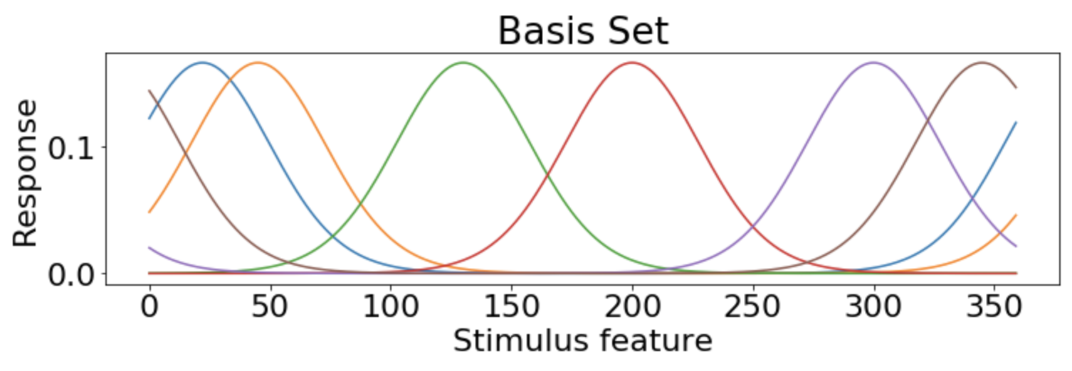
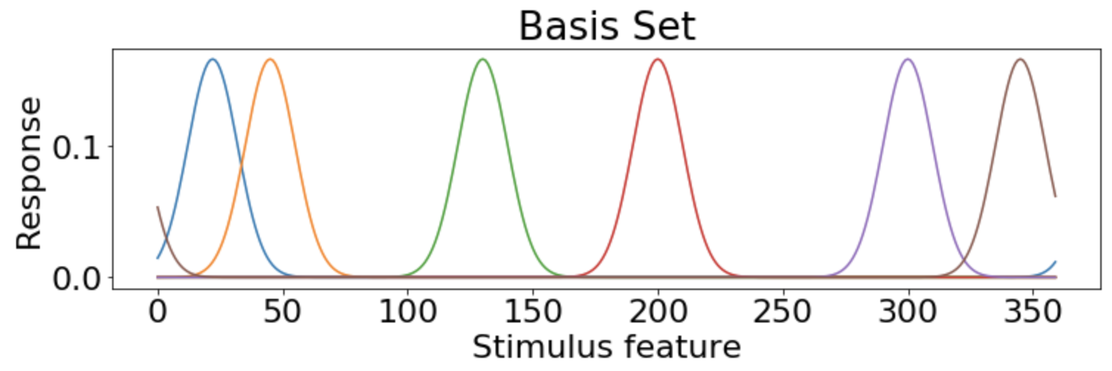
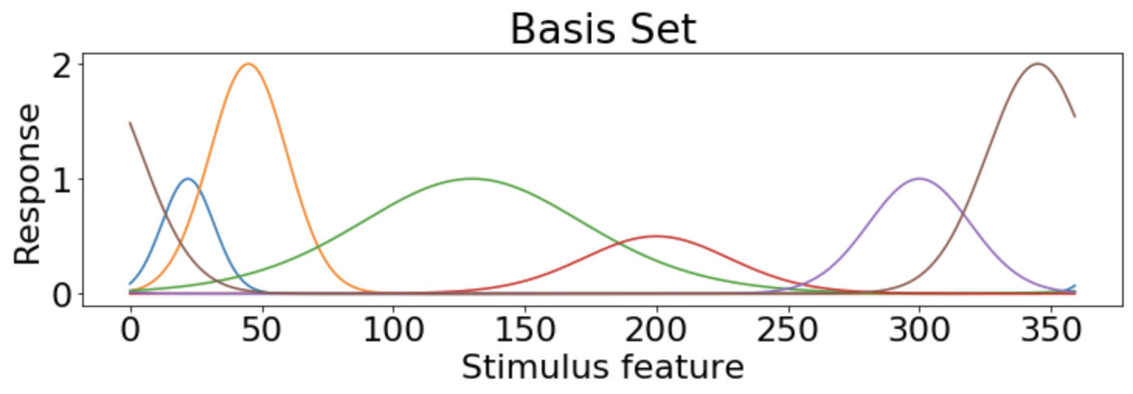
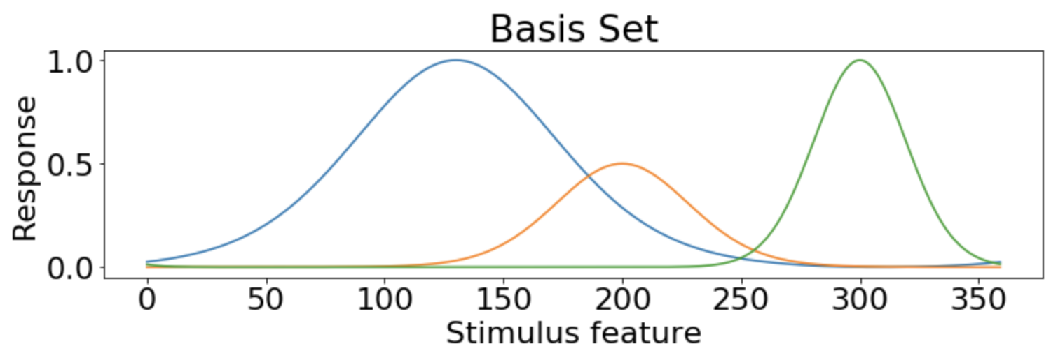
Find the best encoding model

Slide 11
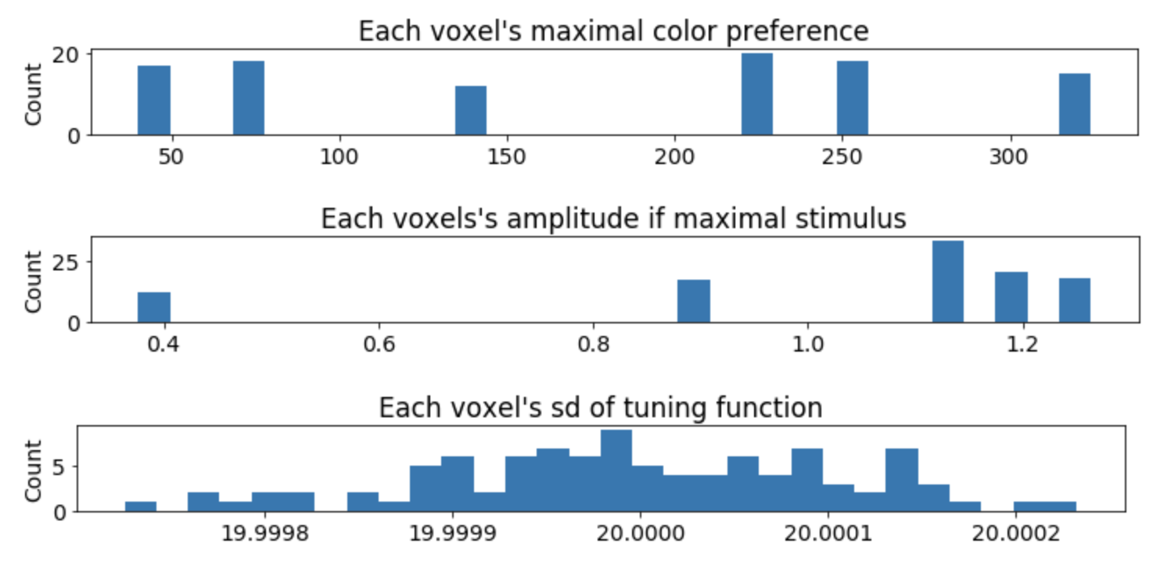
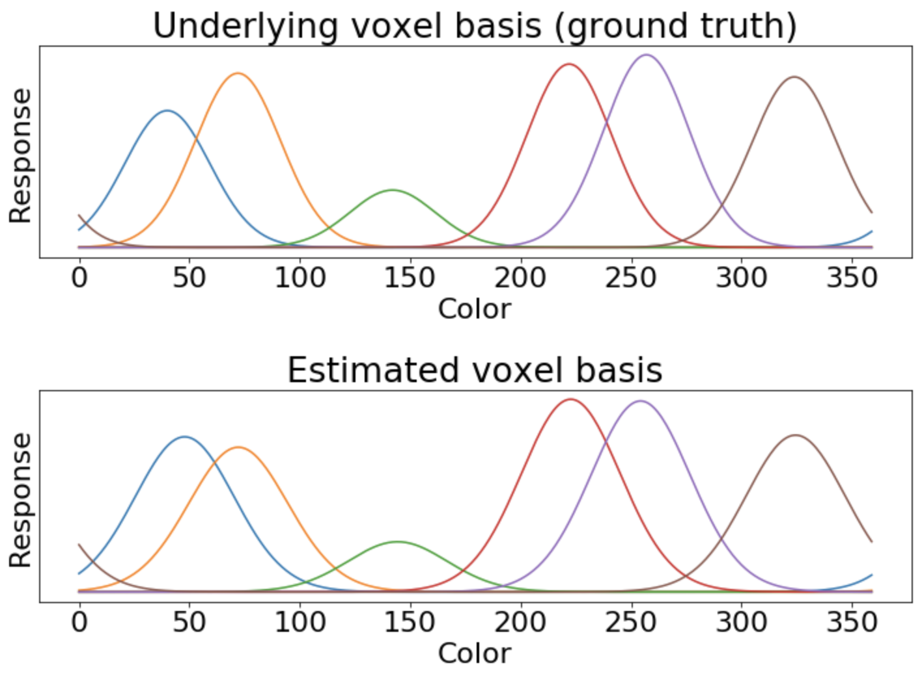
Simulation: Proof of concept
1 subject, 720 trials, 100 voxel ROI
trial_features
Each color represents integer from 0-359, each color occurring exactly twice (randomly intermixed) throughout 720 trials
mu = [40, 72, 142, 222, 257, 324]
sd = [20]
amp = [.15, .19, .06, .20, .21, .19]

Slide 12
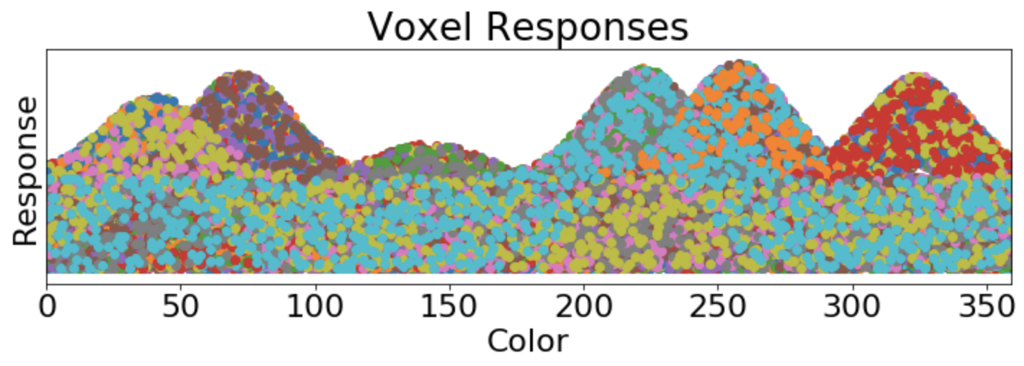
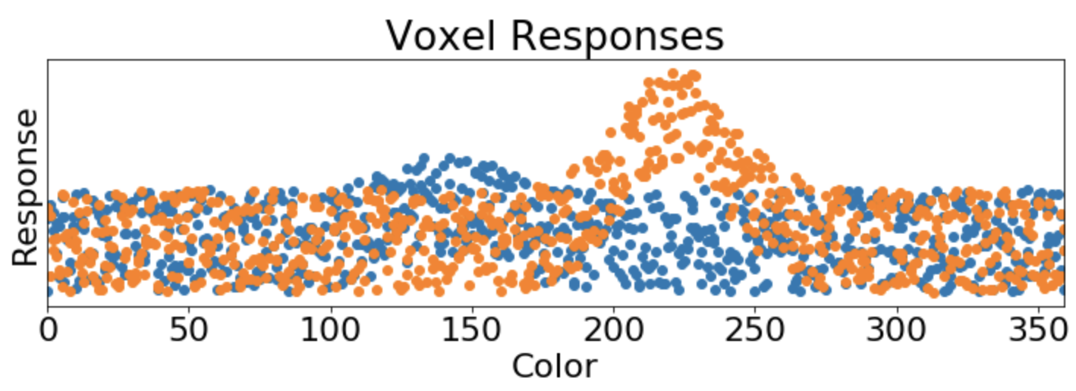
Simulation: Proof of concept
+ noise
Responses of Two Voxels
plt.scatter(trial_features,trial_by_vox[:,vox]) for vox in range(nvoxels)
trial_by_vox is a 720 (trials) x 100 (voxel betas) matrix
It’s the only input data we will use for the model.

Slide 13
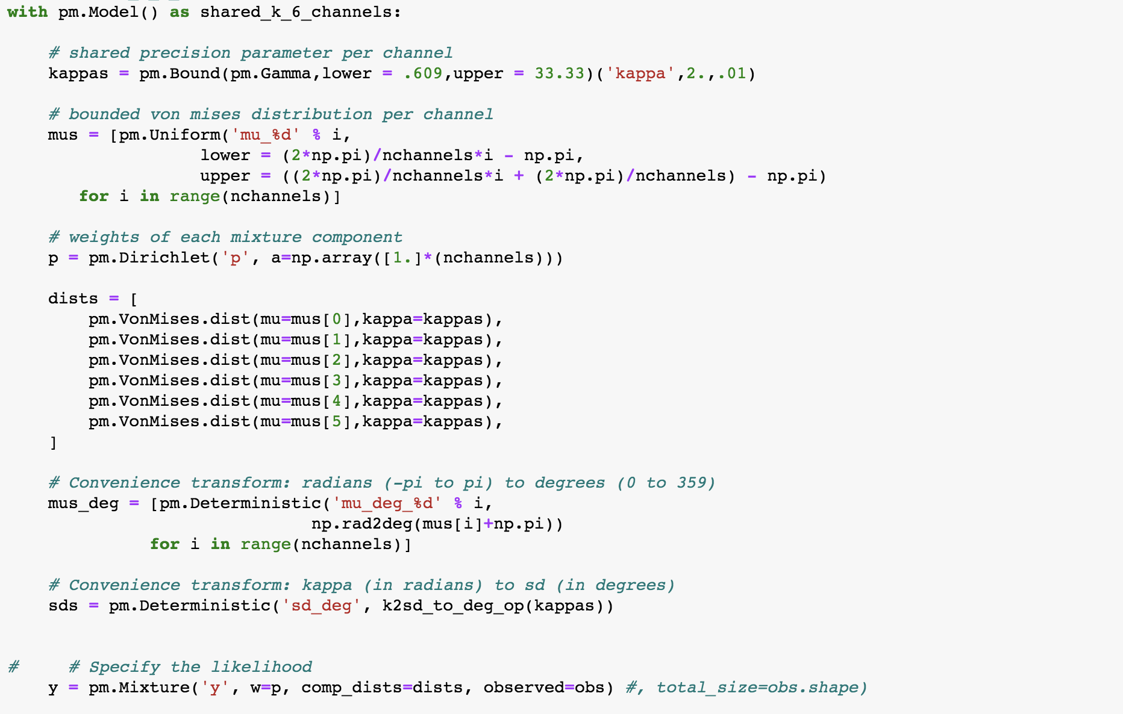
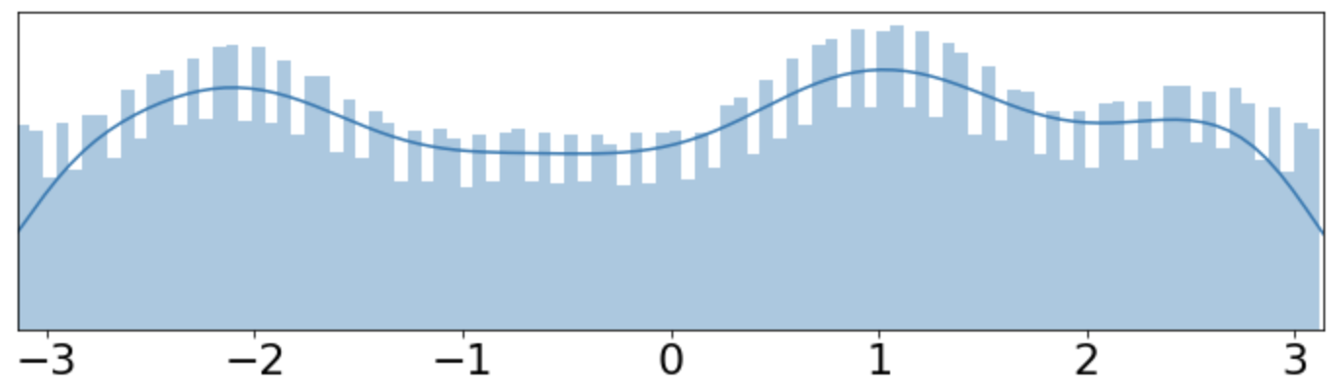

Simulation: Proof of concept
simulate
experiment
inverse transform sampling
PyMC3 Model Fitting

Slide 14
Simulation: Proof of concept

Slide 15
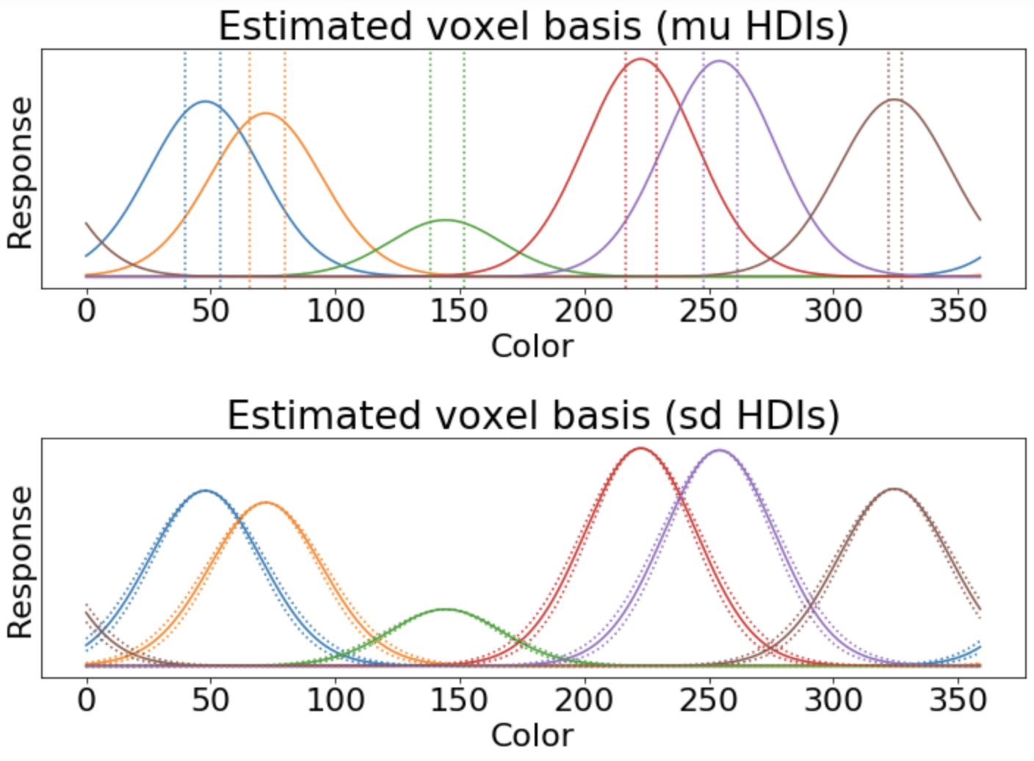
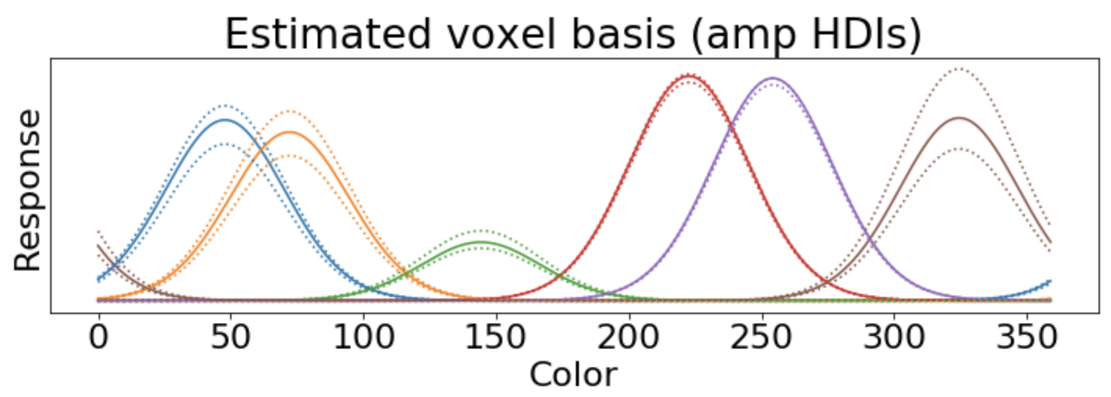
Simulation: Proof of concept
mu = [40, 72, 142, 222, 257, 324]
mu = [47.8, 72.2, 144.3, 222.7, 254.3, 324.5]
sd = [20]
sd = [23]
amp = [.15, .19, .06, .20, .21, .19]
amp = [.17, .16, .06, .22, .21, .18]

Slide 16
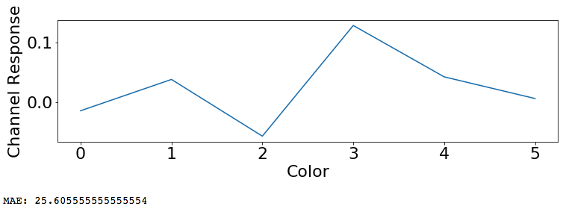
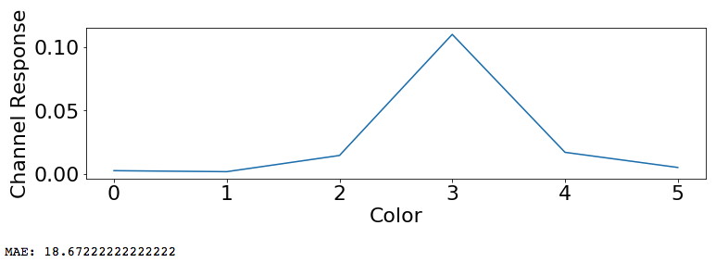
Simulated Basis Set (Ground Truth)
+ noise
Model Prior
Stimulus Reconstruction
Invert encoder &
reconstruct stimuli
(standard IEM method)
Model Posterior
Stimulus Reconstruction
Invert encoder &
reconstruct stimuli
(our method)
Standard deviation
95% HDI
Mean
95% HDI
Amplitude
95% HDI

Slide 17
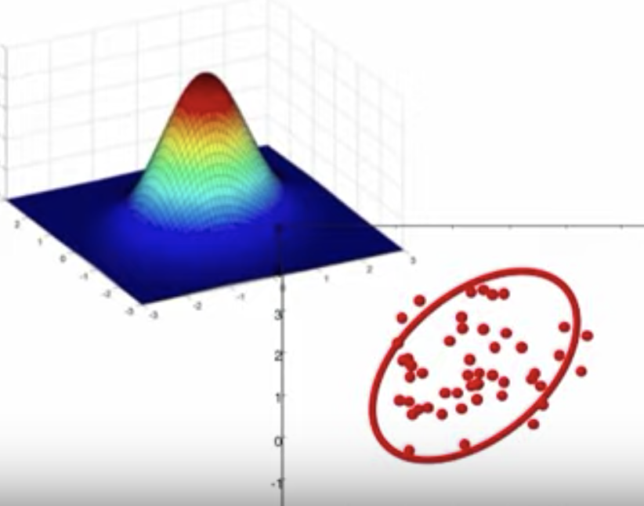
Differences to other techniques
Encoding models: estimate feature weight per voxel
Representational similarity analysis: compare covariance matrices
Pattern component analysis: same goal as RSA, but it estimates a distribution that creates the covariance matrices to compare log-likelihoods (instead of representational distances)

Slide 18
Example research questions it could potentially answer
How does attention to one color change the representation of other colors?
Are our representations of orientation more precise when the stimuli are presented in their canonical orientation?
Is numerosity represented as increasingly spaced and widening channels?
How do we represent faces (using face morphs)? How does this vary across people?

Slide 19
Next steps: real data?
Would this actually work on real data?
What research questions can this answer?
Fitting a representational space, not comparing models. Allows us to compare parameters between conditions just like our behavioral Bayesian mixture models.
What should our focus be on?
Focus on how this method can improve IEM, or focus on this as its own new encoding technique?
What feature space to use?
Doesn’t need to be circular (e.g., color, orientation), but must be continuous
M-sequence or PRF mapping?
Can PRF yield a trial_by_vox matrix the same way M-seq can?

